Slide 1
Your information
What does the AI need to know, and who may see it?
Applied AI and Automation | Session 4 of 12
KLAi Professional Learning | Jotham Martin Wambi
Notes:
Welcome back. Last session you wrote a brief and checked a result. Today we look at the other half: the information the assistant works from. You decide what it needs to know, and who may see it. You leave with an inventory and three clean sample inputs.
The question for today is this: What does the AI need to know, and who may see it? Keep it in mind. At the end of the session we come back to it and see how much more you can say.

Slide 2



Today in one view: what you will leave with
By the end of today you will have
A list of every source of information your own task uses, each marked by sensitivity
A plain picture of how an assistant answers from your files, and why it still needs checking
Three sample inputs for your task: one typical, one difficult, one that must stay out
Notes:
Here is what you leave with today. A list of every source of information your task uses, each marked by how sensitive it is. A plain picture of how an assistant answers from your files, and why that still needs checking. And three sample inputs: one typical, one difficult, and one that must stay out of any tool.

Slide 3
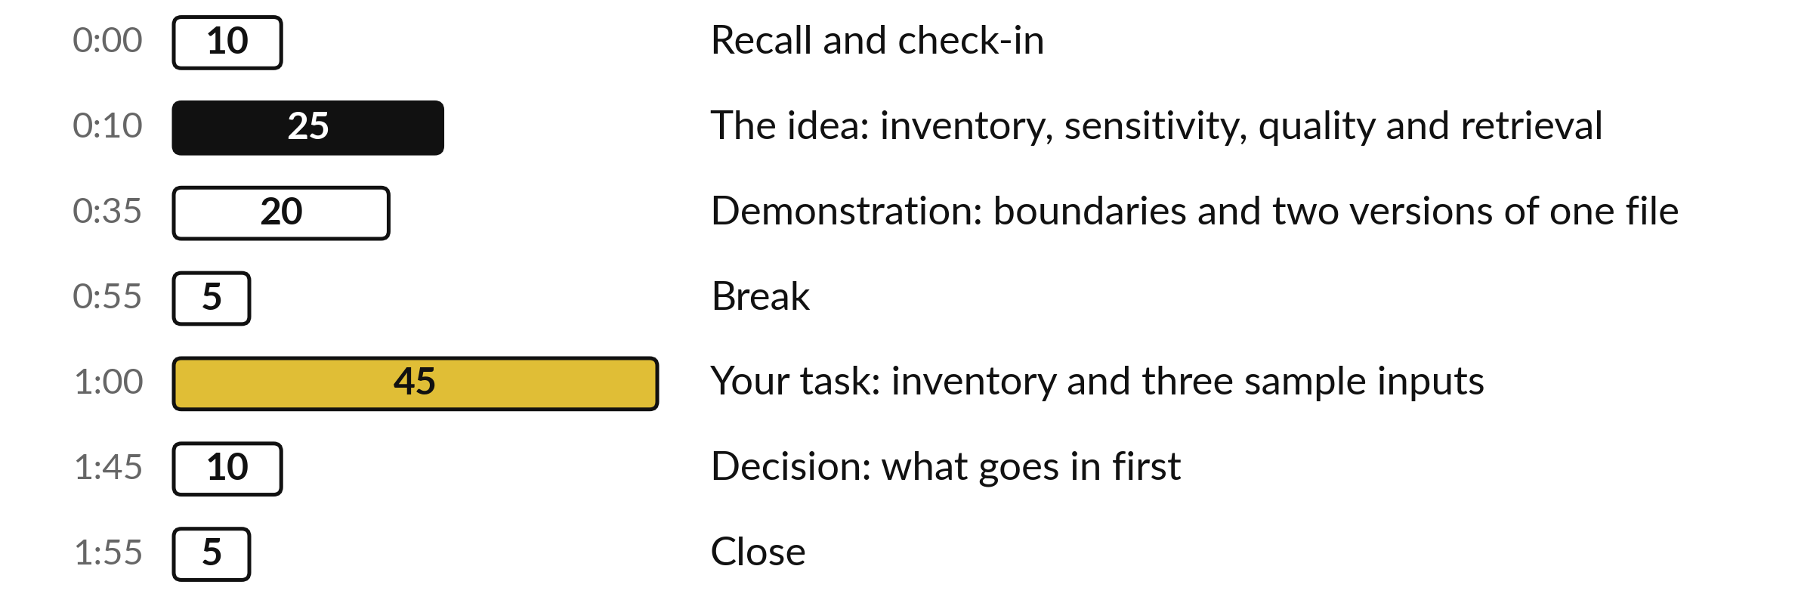
Your two hours: most of
the time is your own work
45 of the 120 minutes are yours: your own inventory and sample inputs.
Notes:
Three parts matter most today. I spend twenty-five minutes on the idea, and twenty minutes on a demonstration with the staff handbook of our case company, this time about boundaries and two versions of one file. Then forty-five minutes are yours: your own inventory and your three sample inputs. If we run long, I shorten my part.

Slide 4

Three questions from last time
1. Name the five questions to answer before you paste company data.
2. Name the seven parts of a brief.
3. Two sources give different figures. What must the briefing do?
Answer aloud first. Then we check together.
Notes:
Three quick questions from Session 3. Answer aloud first, and then we check together. It is a warm-up to bring last time back.
Question one. Name the five questions to answer before you paste company data. Take a moment.
A good answer is this. Does it train on my inputs, how long does it keep chats, who in my company sees them, work or personal account, does company rule allow it. The answers depend on the plan.
Question two. Name the seven parts of a brief. Say it to yourself first.
A good answer is this. Goal, context, inputs, constraints, format with one example of a good answer, how I will check, what to say when unsure.
Question three. Two sources give different figures. What must the briefing do? Think about your own task as you answer.
A good answer is this. Show both figures, name both sources and say what to check.
If an answer was missing, your own task card or last workbook page has it. Now to today.

Slide 5


Words we use today
Word | What it means
Inventory | A list of every source of information a task uses, with its owner, place and sensitivity.
Sensitivity | How much harm follows if information leaks: Public, Internal or Confidential. A Personal flag is added when it identifies a living person.
Retrieval | The assistant splits files into chunks, searches them, and passes the best few passages into its context window to answer from.
Permission | Who is allowed to see a document. The assistant must follow the same rule.
Notes:
Four words for today. I give the plain meaning of each, and we use every one of them before the end of the session.
Inventory. A list of every source of information a task uses, with its owner, place and sensitivity.
Sensitivity. How much harm follows if information leaks: Public, Internal or Confidential. A Personal flag is added when it identifies a living person.
Retrieval. The assistant splits files into chunks, searches them, and passes the best few passages into its context window to answer from.
Permission. Who is allowed to see a document. The assistant must follow the same rule.

Slide 6
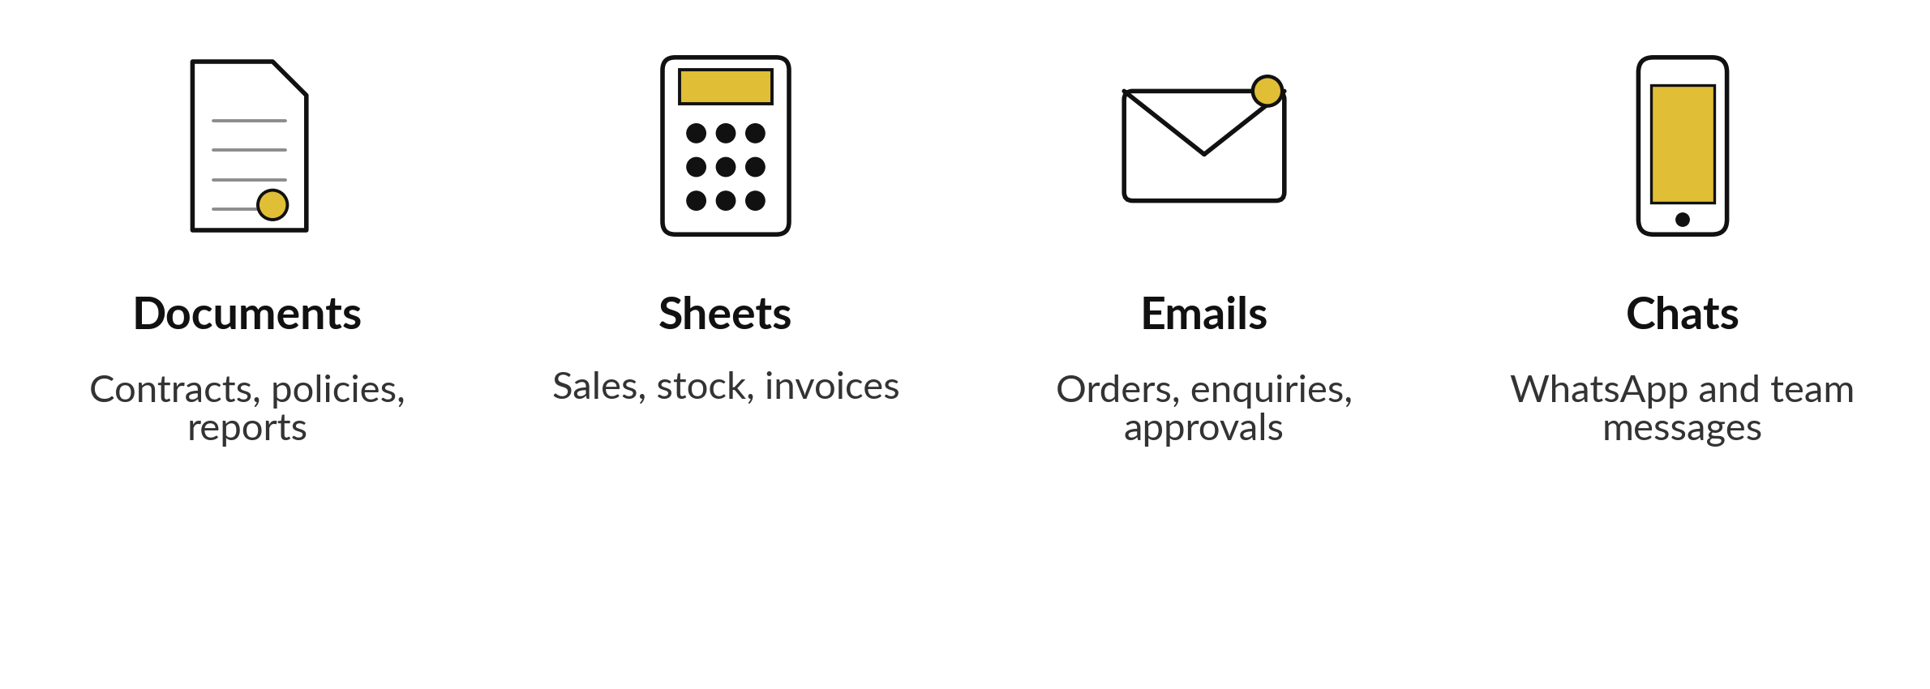
Your task draws on four kinds of information
List every one your own task uses, with its owner and where it lives.
Notes:
Start with an inventory. Your task draws on information, and it usually sits in four places: documents, sheets, emails and chats. At Nile Valley Foods, orders arrive on WhatsApp, prices sit in sheets, contracts are documents in Drive, and approvals come by email. Before you ask an assistant to help, list every source your task uses, who owns it, and where it lives.
You cannot protect or clean information that you have not listed. Before I go on, name one source your own task uses, and say who owns it.

Slide 7
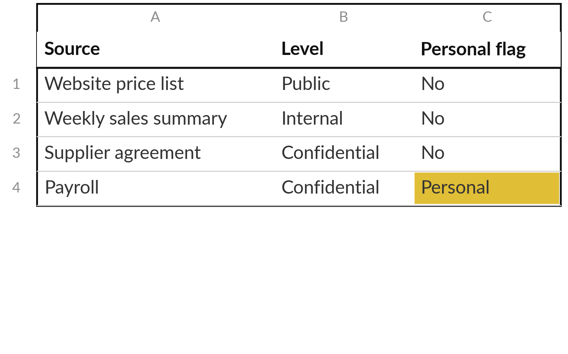
Three levels and one flag: label every source
Payroll is both Confidential and Personal. Treat it by the stricter rule.
Label the level, then add the flag.
When unsure, use the higher level.
Your policy sets the final rule.
Notes:
Three sensitivity levels, from low to high, and one flag. Public is meant for anyone, like a price list on a website. Internal is for staff, such as the weekly sales summary. Confidential would harm the company if it leaked, such as a supplier agreement or bank details.
Then there is the Personal flag, which sits on top of a level. It means the information identifies a living person, such as a CV, a phone number or payroll. Payroll is both Confidential and Personal, and you treat it by the stricter rule. Label each source before you paste anything. When you are unsure, choose the higher level.

Slide 8




What may go into which tool
Level | Example | Which tool
Public | Price list on the website | Any assistant you may use
Internal | Weekly sales summary | A tool the company has approved
Confidential | Busoga Oils supply agreement | Approved tool, needed passage only, bank details removed
Personal flag | CVs, payroll, a clinic’s patient list | Only a tool approved for personal data, or keep out
A starting guide. Your company policy decides, and you write it in Session 9.
Notes:
This table is a starting guide for what may go where. Public information can go to any assistant you are allowed to use. Internal needs a tool the company has approved. Confidential needs an approved tool, only the passage you need, and bank details and similar removed first.
The Personal flag adds a rule on top of any level. CVs, payroll, a clinic patient list and a bank list of account holders all identify living people, so they need a tool approved for personal data, or they stay out. At Nile Valley Foods, handbook clause 4.4 already says that customer data, price lists and contracts need the Managing Director to approve the tool in writing.

Slide 9
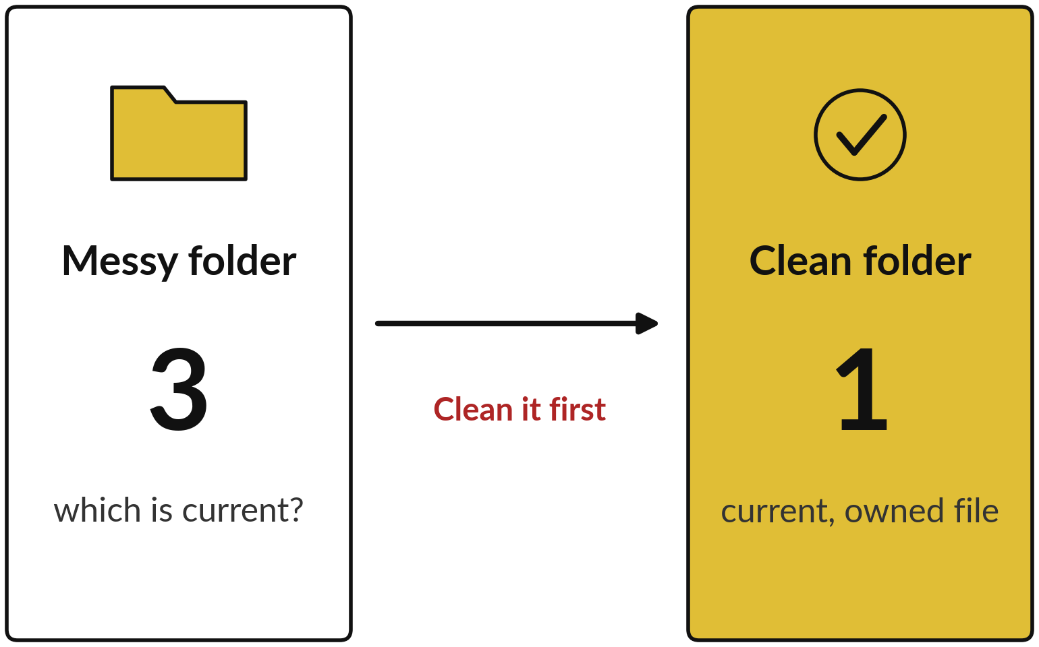
Clean information gives better answers
An assistant cannot tell which of three files is the real one.
One current file, with a date.
A name a stranger can read.
One named owner, no old copies.
Notes:
An assistant cannot tell which of three files is the real one, as the picture on the left shows. So the quality of the information sets the quality of the answer. Five basics sit behind the three points on the right. One version of the truth. Clear file names.
A date on every document and sheet. No duplicates or old copies beside the current one. And one named owner for each source. In the demonstration you will see what happens when an old copy sits beside the current one. Fixing these helps your staff as much as the assistant.

Slide 10
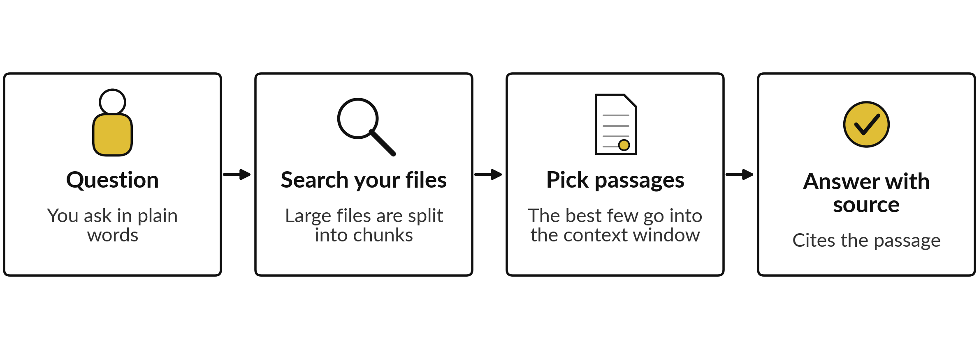
Retrieval: search the files, pass
the best passages, answer
Each step can fail, so you still open the cited passage.
Notes:
This picture shows retrieval, the idea behind assistants that answer from your files. If you attach a few small files, the tool can often put them straight into the context window, the working space from Session 2. Retrieval matters when the folder is large. The tool splits the files into chunks, searches them, and passes only the best few passages into the context window.
Then it writes an answer from those passages and shows where they came from. But each step can fail: it may pick the wrong passage, or write more than the passage says. So you still open the cited passage and read it.

Slide 11

The assistant must not show
what the asker may not see
Connect an assistant only to files its users may already open.
If it can reach a file, it can quote it.
Keep payroll and contracts in restricted folders.
Personal data falls under the Data Protection and Privacy Act 2019.
Sending it abroad may be restricted. Ask your lawyer.
Notes:
A permission is a rule about who may see a document. If you connect an assistant to a folder, anyone who can ask it questions may be able to read what it quotes. So connect it only to files that every user could open anyway, and keep payroll, contracts and similar files in restricted folders.
One point on law. In Uganda, the Data Protection and Privacy Act 2019 applies to personal data, including when you use AI. My understanding is that sending personal data across borders is restricted under the Act. Many AI tools process data abroad, so check with your lawyer first. We cover the law in Session 9.

Slide 12
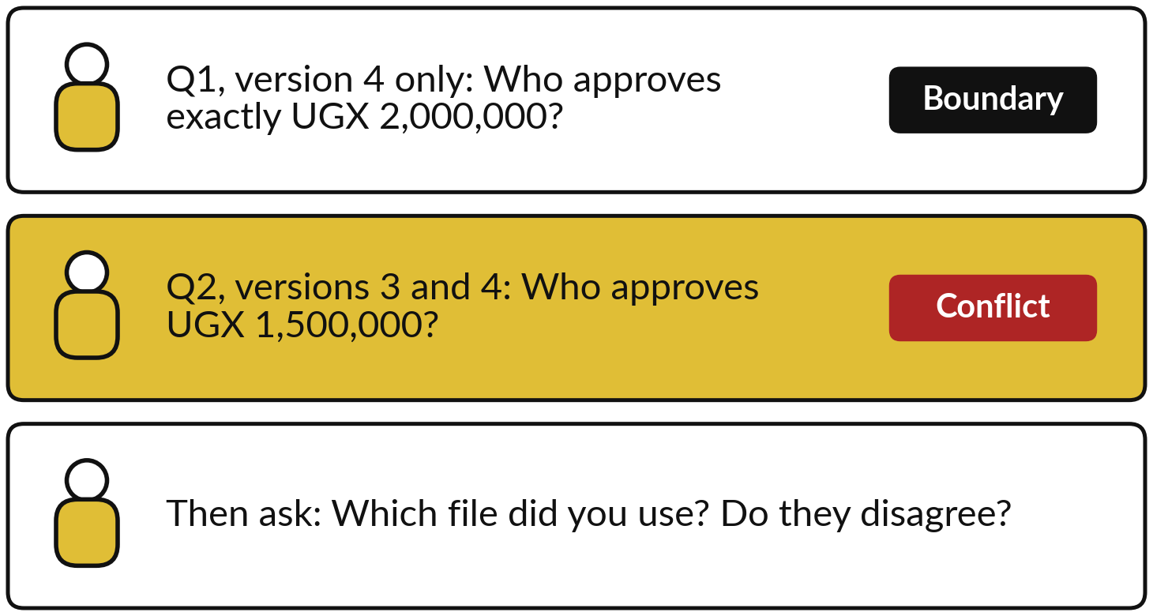
Demonstration: boundaries,
and two versions of one file
I will show
Watch for
Does it apply the band correctly at the edge?
Does it say that two files disagree?
Does it name the file and the clause?
Notes:
Now the demonstration, again with the fictional staff handbook, for a different reason from last time. First a boundary question: who approves a claim of exactly two million shillings?
The band runs up to two million, so the answer from the handbook is the Finance Manager. Then I attach an old version three beside version four. The two files give different answers for one million five hundred thousand. Watch whether the tool applies the band at the edge, whether it tells us the files disagree, and whether it names the file and the clause.
The passages it uses go into the context window, as in Session 2. We check the live result.

Slide 13
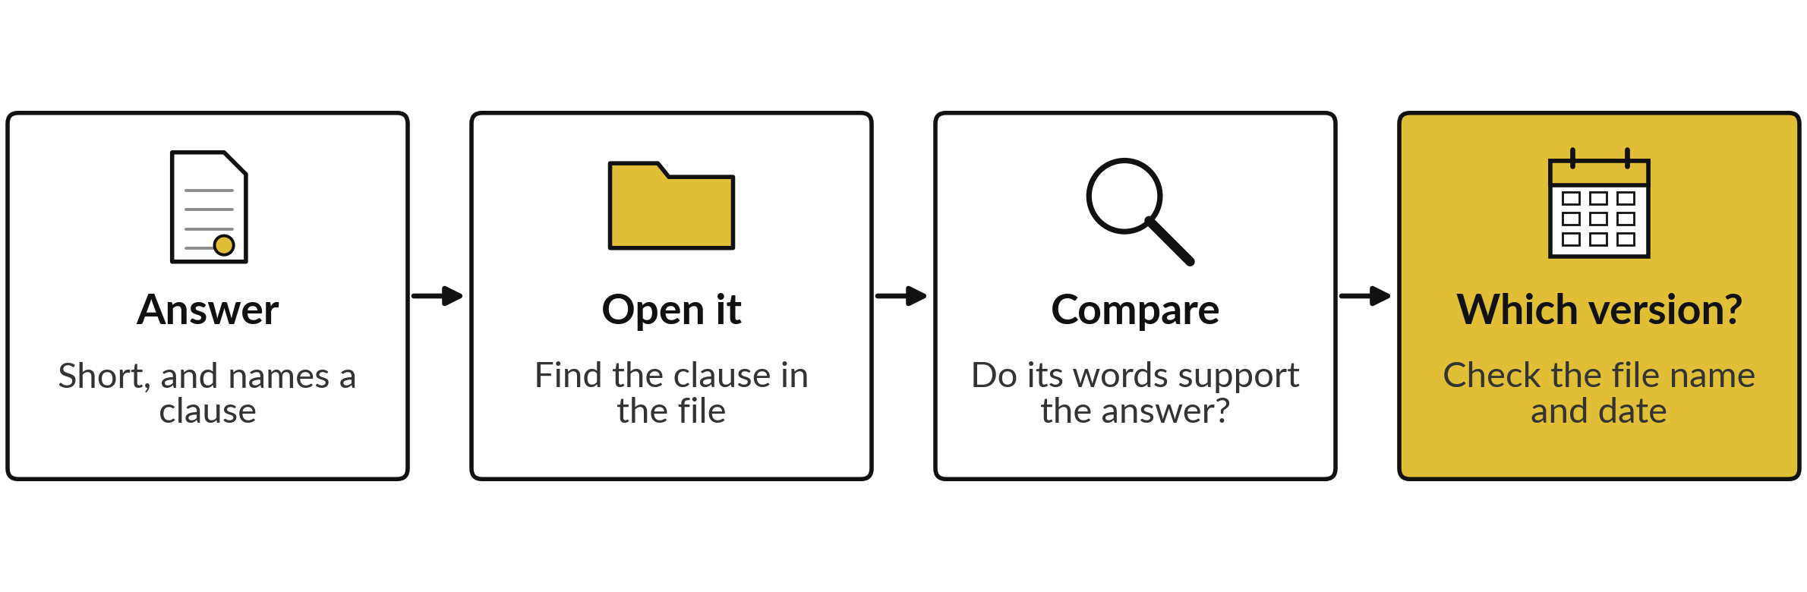
A checked answer: open the
clause, then check which file
When two files disagree, a tool may choose one without saying so. You will check the live result.
Notes:
This is the shape of a good result, and I have not claimed any particular answer, because you will see the live result. The answer is short and names a clause. You open that clause and read the words it relies on. Do they match the answer?
Then check which file it came from, by name and date. If two versions disagree and the tool chose one without telling you, that goes in your record, and the fix is the one we saw earlier: one current file, dated, with an owner. Checking takes under a minute when the tool cites its passage.

Slide 14
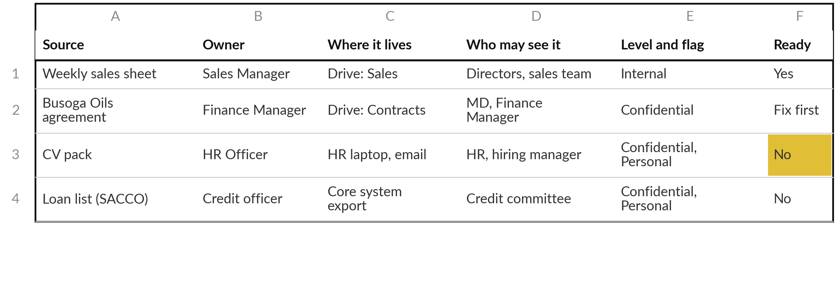
A finished inventory: owner,
place and who may see it
Illustrative. The template adds format, how often it changes, quality and what to fix first.
Notes:
Here are four rows in the shape of your template: three from the fictional food company and one from a SACCO. Read across each row. The sales sheet has an owner, a place on Drive and a short list of people who may see it, so it is ready.
The supplier agreement is confidential and ready only after a fix, which the template records in its last column: remove the bank details first. The CV pack and the member loan list are Confidential and Personal, so the answer is no, keep them out unless a tool is approved for personal data.
Each row ends with a decision, and the decision is what you act on.

Slide 15
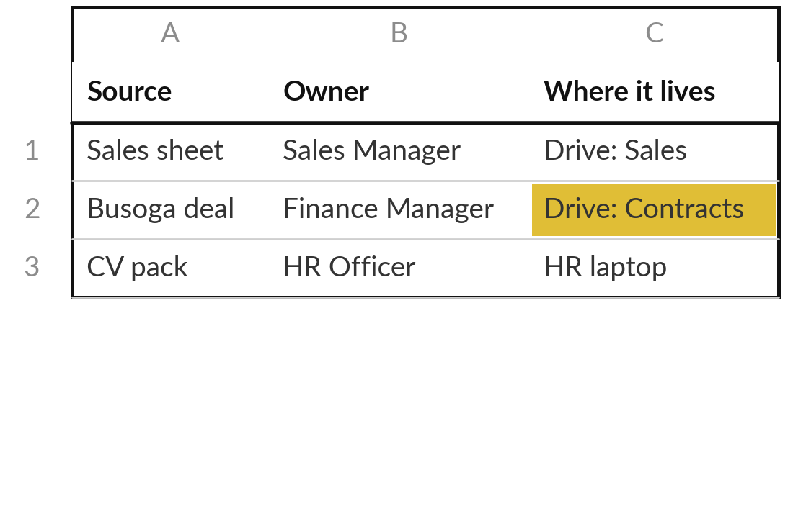
Practice: list every source your task uses
15 minutes
Your own company task
Build your Information Inventory.
Open the Information Inventory template.
List each source: documents, sheets, emails, chats.
Add owner, where it lives and who may see it.
Mark the level, add the Personal flag if it applies, and score quality 1 to 5.
You keep: An inventory with every source marked by level and flag.
Notes:
Take fifteen minutes. Open the Information Inventory. List every source your own task uses, one per row: documents, sheets, emails, chats. For each one write the owner, where it lives, who may see it and how often it changes. Then mark its level, add the Personal flag if it identifies a living person, and give its quality from one to five.
If you do not know the owner, that is a finding, so write unknown. Aim for at least six sources. I will walk round and check your labels with you.

Slide 16
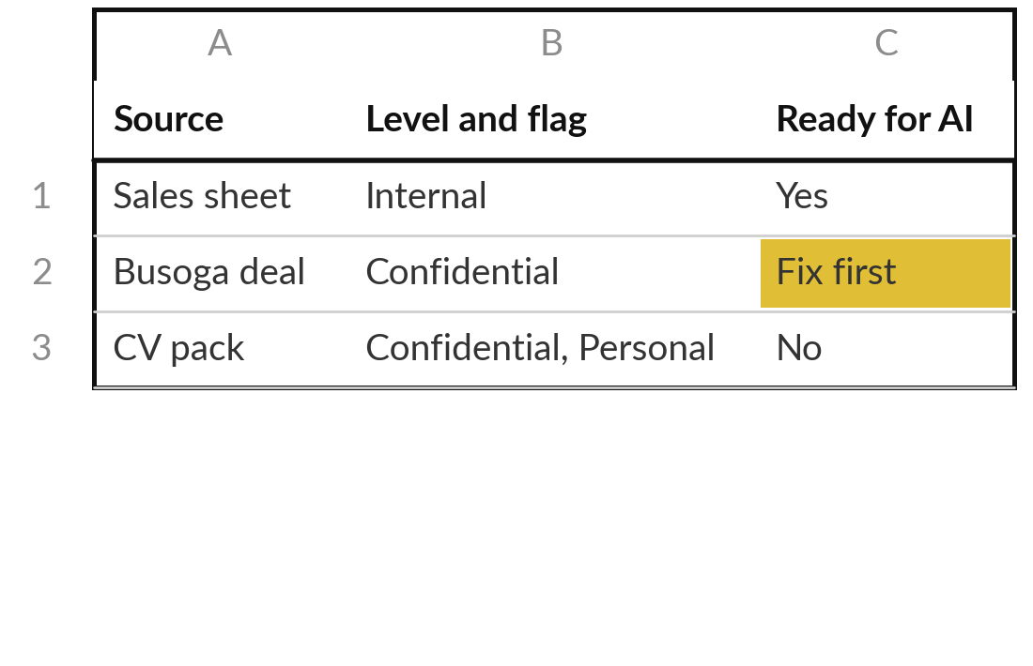
Practice: decide which sources are ready for AI
15 minutes
Your own company task
Mark each source Yes, Fix first or No, and choose three sample inputs.
Mark each source: Yes, Fix first or No.
Write what to fix for each Fix first.
Choose a typical sample input.
Choose a difficult one, and one that must stay out.
You keep: Every source marked, and three sample inputs chosen.
Notes:
Next fifteen minutes. Mark each source: yes, fix first, or no. Where you write fix first, say what to fix. Then choose three sample inputs from your task. One typical, the ordinary case. One difficult, for example a messy email, or a case with missing information. And one that must stay out, a real example you would never paste, so that the whole team knows the line. Write the reason for each choice.

Slide 17
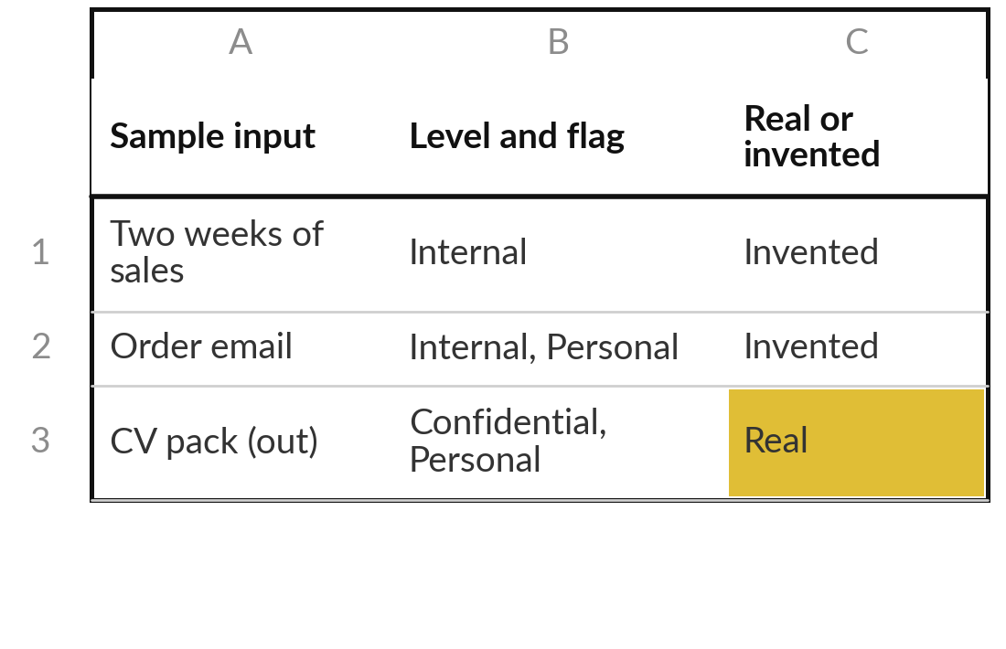
Practice: clean and save the three sample inputs
15 minutes
Your own company task
Prepare the three inputs so they are safe to use.
Replace names, numbers and contact details with invented ones.
Remove duplicates and old versions.
Note the level and flag of each on the Sample inputs sheet.
Save them in one folder.
Update part 3 (Inputs) of your Session 3 brief with your cleaned sample.
You keep: Three clean sample inputs, and part 3 of your brief updated.
Notes:
The last fifteen minutes. Prepare your three samples. Replace real names, numbers and contact details with invented ones. Remove duplicates and old versions. On the sample inputs sheet, record where each sample came from, its level and flag, whether it is real or invented, and whether identifiers are removed.
The one that must stay out is not cleaned. You describe it and label it, and you keep it away from tools. Save all three in one folder. Last, open your Session 3 brief and update part three, the inputs, with your cleaned typical sample.

Slide 18



Decision: what goes to the assistant first?
Which information will you give the assistant first for your task?
Safe samples
Internal data
Nothing yet
Public or invented only. Build and test the brief first.
Real figures, an approved tool, a clear check.
The tool is not approved, or sources need fixing first.
Write your choice, and the first fix you will make, on the inventory.
Notes:
Time to decide. What will you give the assistant first?
Option one, public and invented information only. It carries the least risk, and you can build and test your brief. Option two, internal information with a tool your company has approved, a real task and a clear check. Option three, nothing yet, because the tool is not approved or sources need fixing first.
Most executives start with option one or two. Say your choice aloud, and then write it and the first fix you will make on the inventory.

Slide 19
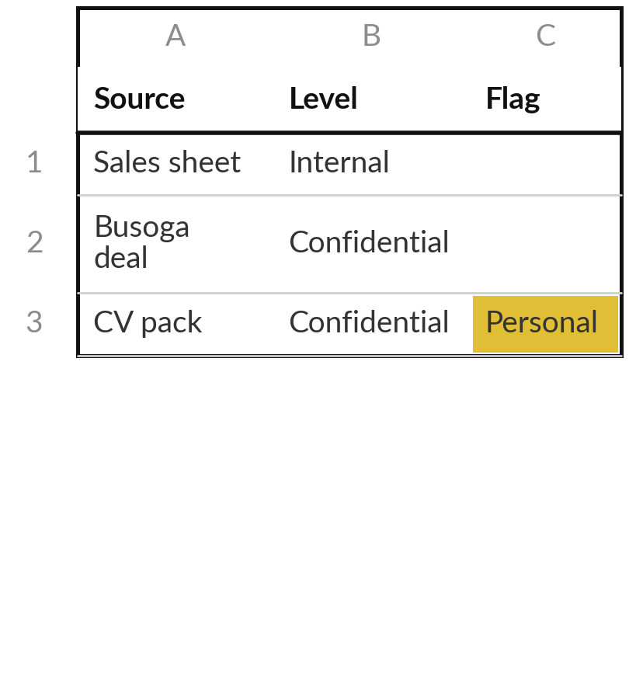
Save it, and keep it for the next session
What you keep from today
Your Information Inventory and three sample inputs, each marked by sensitivity.
Our question today
What does the AI need to know, and who may see it?
Next session
Session 5: Reviewing documents. You will use your own documents to build a review table with sources.
Notes:
Keep the inventory and the three sample inputs, because Session 5 uses your own documents to build a review table. Optional before then: ask the owner of one source on your list whether it is the current version, and write the answer in the inventory. Your Session 3 brief now has a cleaner part 3, so run it once more if you have time.
We began with this question: What does the AI need to know, and who may see it? Before you go, say in one sentence what you can now say about it.

